Slide 1

Supermarket Sweep
Kevin Dee, Quentin Mot, Jake Paupe, & Lea Seaberg

Slide 2
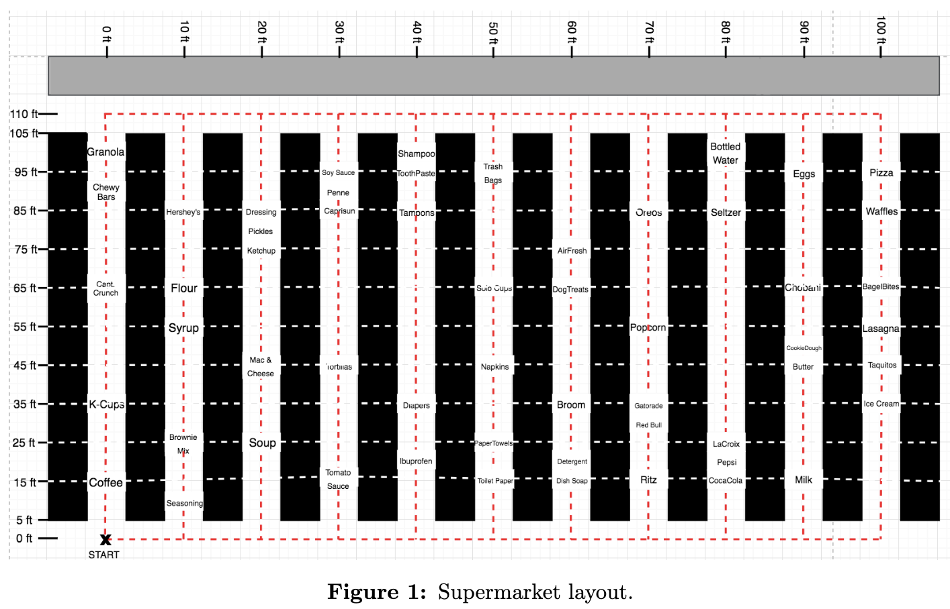
Problem Description
Goal: Maximize the total value of the items the shopper brings back
Constraints:
Continuous path – no teleporting
Shopper can grab only one of each item
Shopper has 90 seconds and a cart capacity of 15 items
Shopper moves at a rate of 10 ft/s and takes 2 seconds to get an item

Slide 3
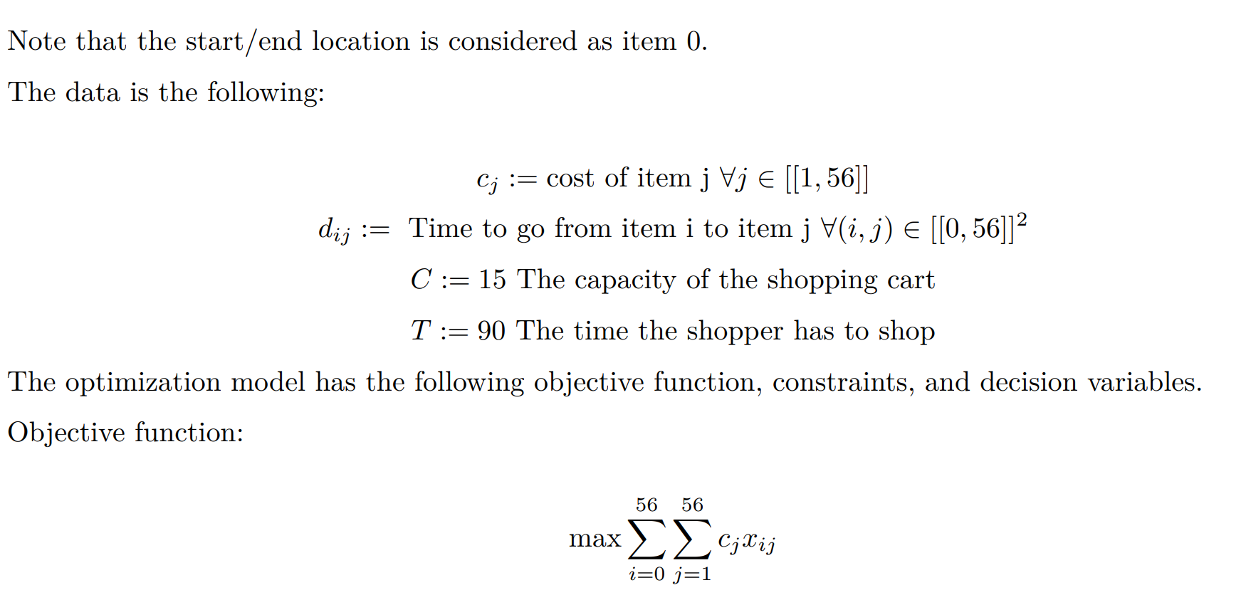
Mathematical Formulation:
Data and Objective Function

Slide 4
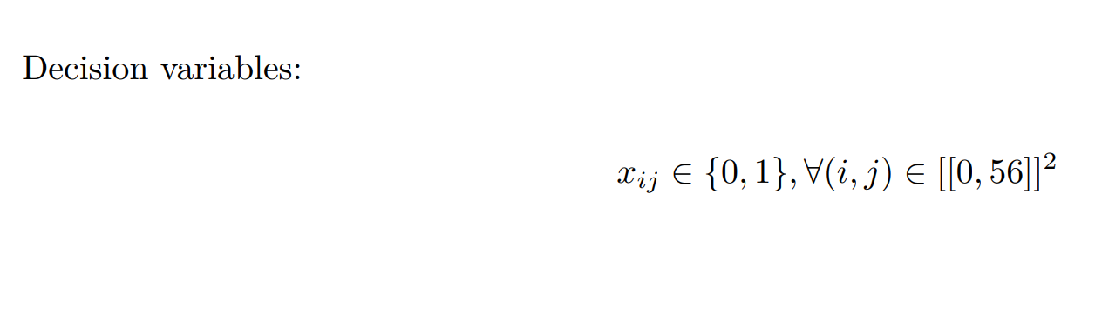
Mathematical Formulation:
Decision Variables

Slide 5
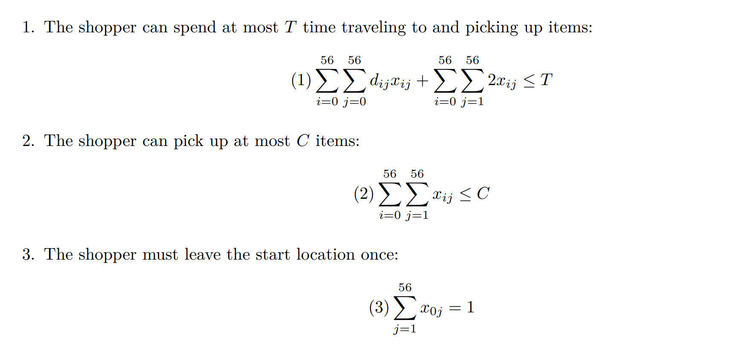
Mathematical Formulation:
Constraints

Slide 6
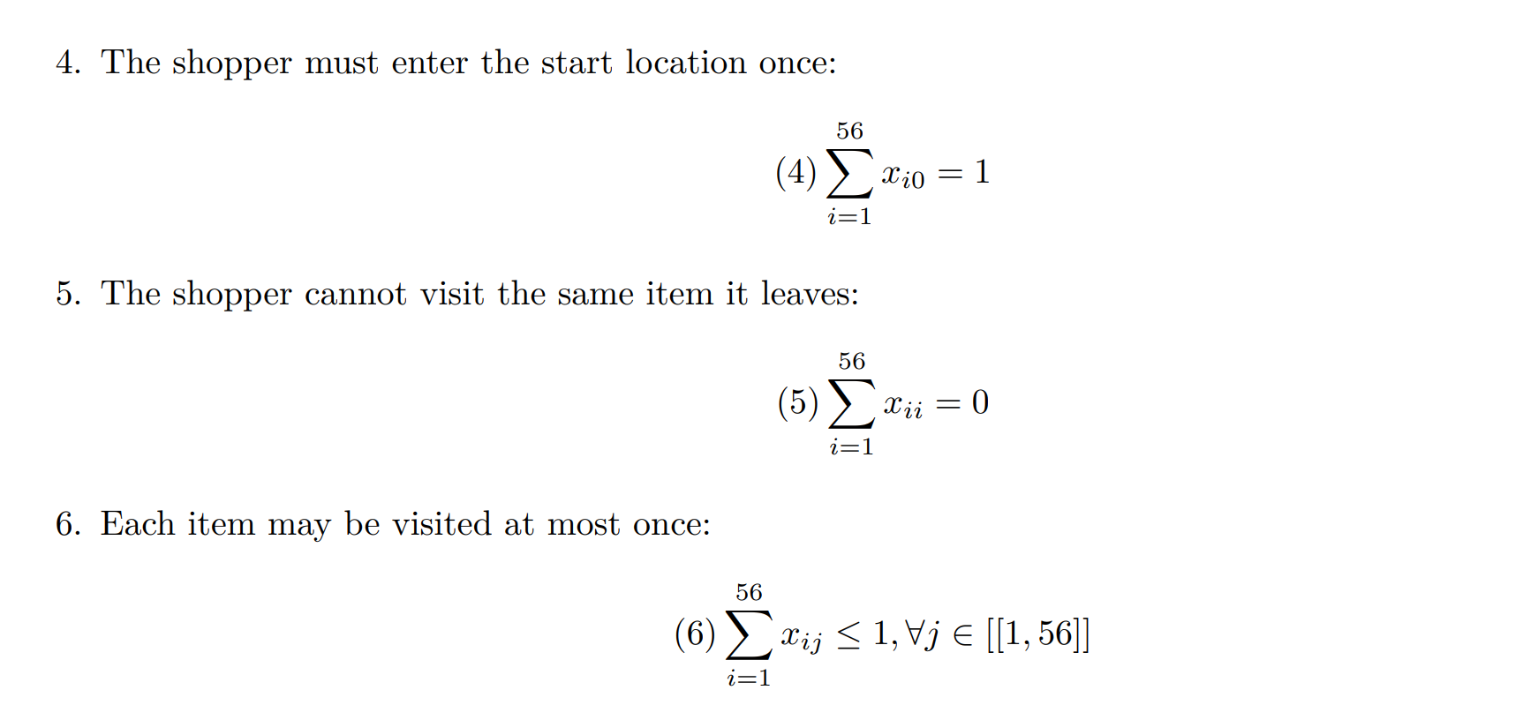
Mathematical Formulation:
Constraints

Slide 7
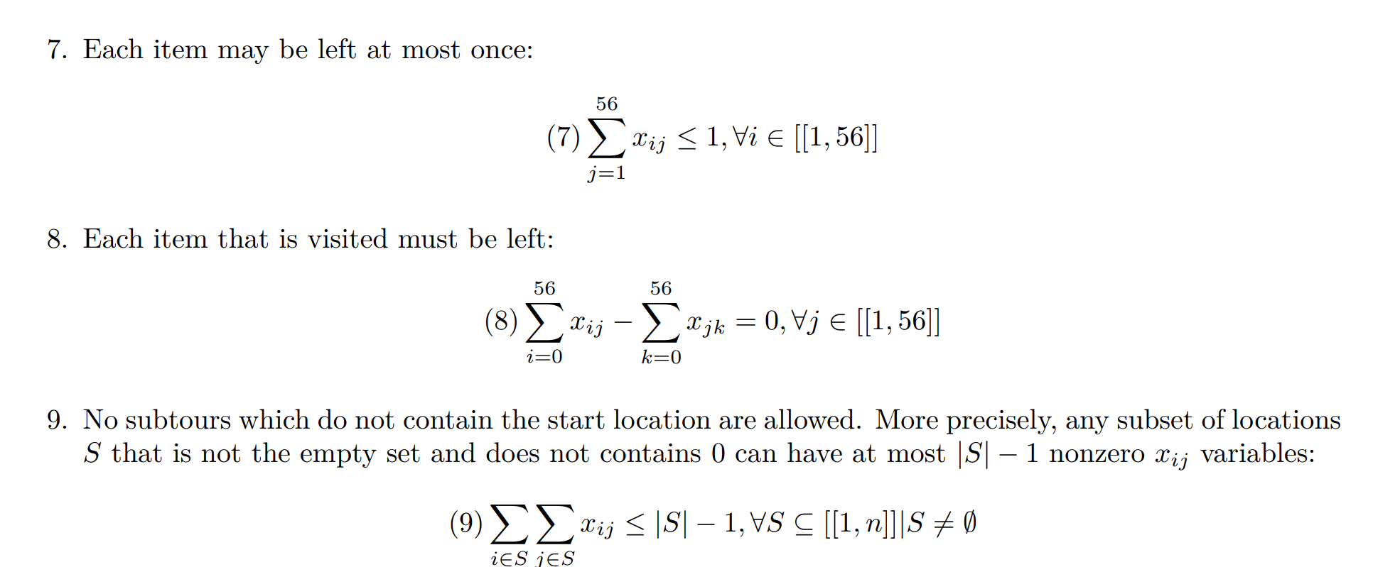
Mathematical Formulation:
Constraints

Slide 8
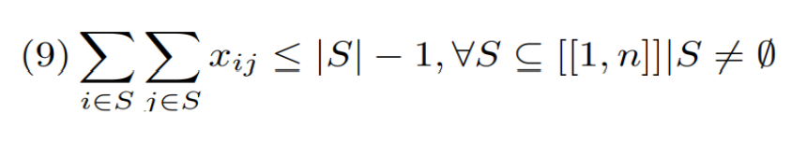
Lazy Constraint Discussion
Cannot add all constraints attached to (9)
Will have negative impact on runtime
Only remove Subtour from consideration when we encounter it

Slide 9
Original Algorithm
Solve Model (Time = 90, Capacity = 4) and Identify Tour(s)
Tour #1: (0 → 1 → 0)
Tour #2: (23 → 24 → 25 → 23)
If # of Tours = 1:
Optimal Solution → Terminate Algorithm
Else:
Save Subtours without Start Node (denoted as 0) to Subtour Storage
(23 → 24 → 25 → 23) added to storage
Start over from Step (1)

Slide 10
Original Algorithm Observations
Will converge to optimal solution eventually
Will not remove ANY subtours connected to Start Node
Ensures we don’t remove optimal solution, but…
Considers solutions we know aren’t optimal
(0 → 1 → 0)

Slide 11
Improved Algorithm
Last Optimal Value = $52.97 (Time = 90, Capacity = 3)
Solve Model (Time = 90, Capacity = 4) and Identify Tour(s)
Tour #1: (0 → 1 → 0)
Tour #2: (23 → 24 → 25 → 23)
If # of Tours = 1:
Optimal Value = Last Optimal Value → Terminate Algorithm
Else:
Save Subtours to Subtour Storage that:
Do not include Start Node
(23 → 24 → 25 → 23) added to storage
Include Start Node AND have value less than Last Optimal Value
(0 → 1 → 0) → $6.99 < $52.97
(0 → 1 → 0) added to storage
Start over from Step (1)

Slide 12
Improved Algorithm Observations
No longer gets “stuck” on poor solutions connected to Start Node
(0 → 1 → 0)
Ramping up through Capacity (T = 90, C = 1) → (T = 90, C = 2) … (T = 90, C = 15)
Solve time of ~15 minutes
Ramping up through Time (T = 5, C = 15) → (T = 6, C = 15) ... (T = 90, C = 15)
Solve time of ~5 hours

Slide 13
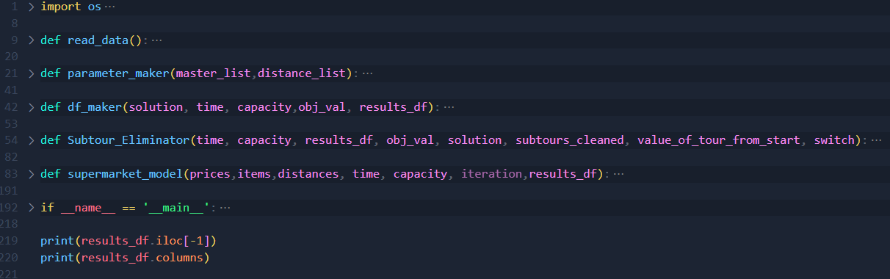
3.3: Code: Functions

Slide 14
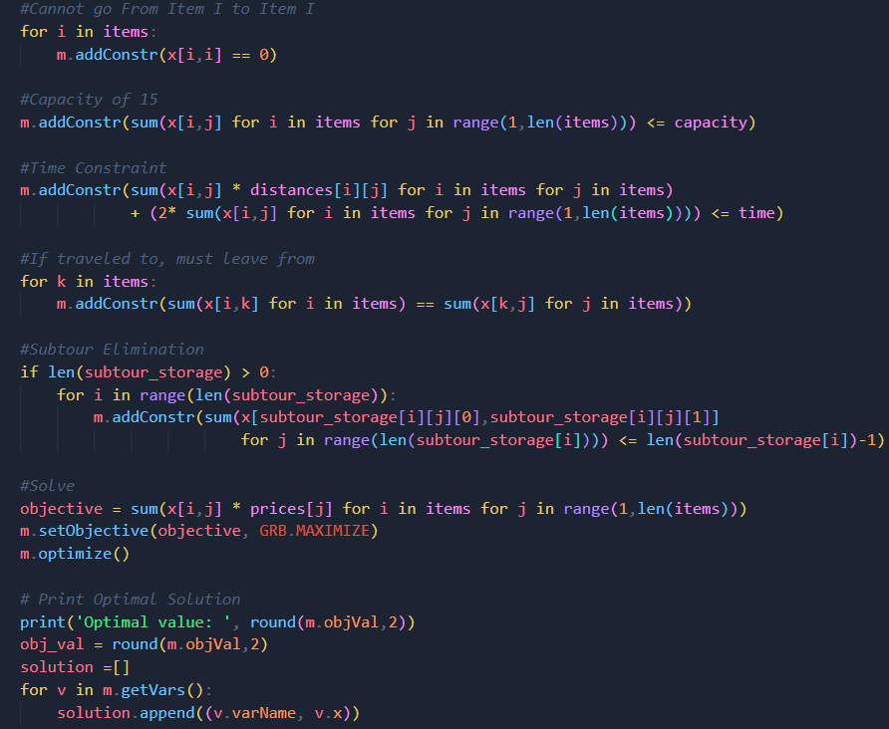
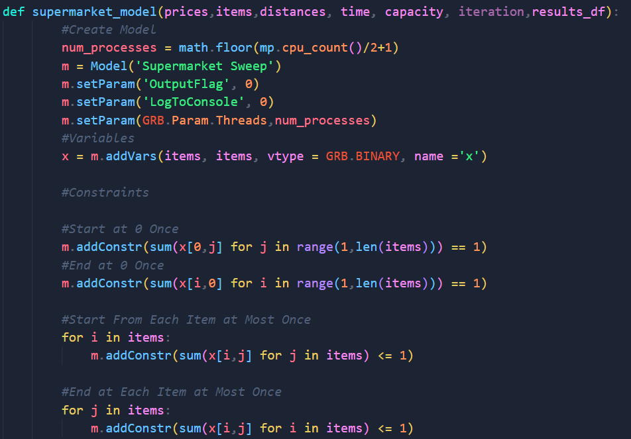
3.3: Code: Model

Slide 15
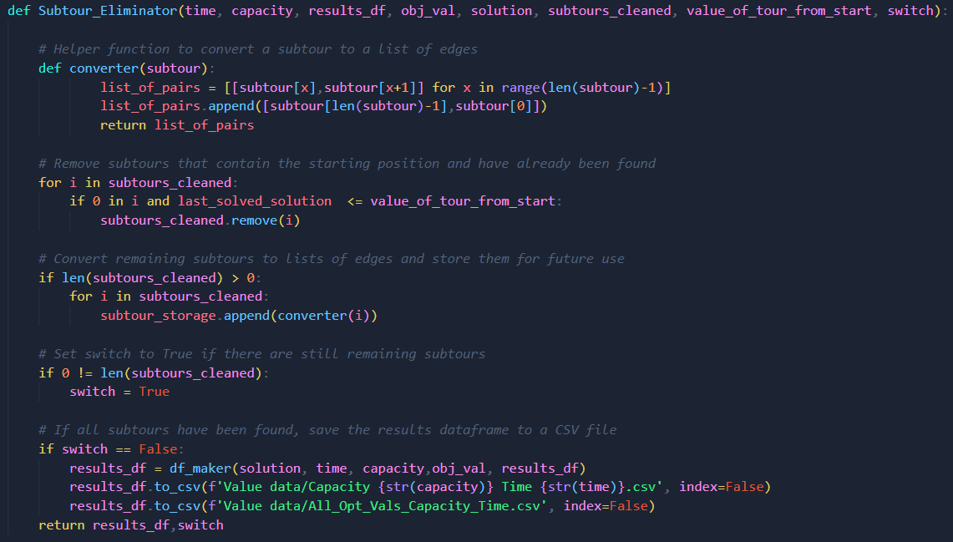
3.3: Code: Subtour Eliminator

Slide 16
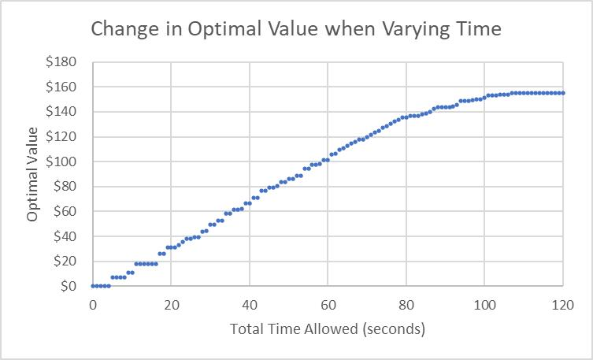
Varying Constraints:
Time
Plateaus at 107 seconds
At a value of $154.85

Slide 17
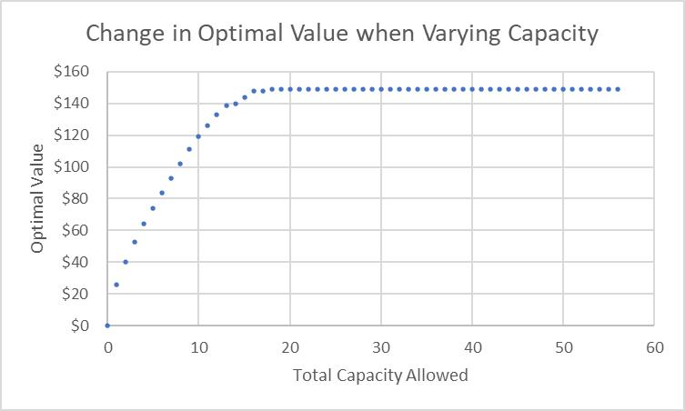
Varying Constraints:
Capacity
Plateaus at 18 items
At a value of $148.82

Slide 18
Varying Constraints:
Time vs. Capacity
Time
Plateaus at 107 seconds
At a value of $154.85
Time has a greater effect on the objective value than the capacity does
Capacity
Plateaus at 18 items
At a value of $148.82

Slide 19
Questions

